Slide 1
CS105 Final Project
Jahnavi Naik, Eva Choudhary, Liam Pinson, Simarpal Singh, Arjun Khanna

Slide 2
Main Question:
Will a person accept a coupon recommended to them in different driving scenarios?

Slide 3
Data Set
Obtained from UCI Machine Learning Repository and was donated in 2020
The types of coupons were for the bar, a coffee house, a takeout place, a restaurant less than $20, and a restaurant $20-$50 and the coupon would either expire in 2 hours or 1 day
Various different attributes were collected such as income, how many times they go to the given place, age, and how far they were from the place

Slide 4
Data Cleaning
Removed columns we thought were not needed for our analysis, including occupation, education, and car type
Found NaNs in the columns asking how often they frequent the bar, coffee house, takeout, and the 2 types of restaurants
The possible choices had a natural ordering : never, less than 1, 1-3, 4-8, greater than 8, so we decided to order the data points that we had and found the median for each, then replaces the NaNs with these medians

Slide 5
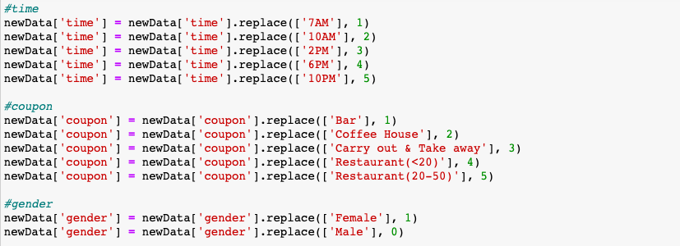
Data Cleaning
In order to perform the KNN classification, we needed to change the categorical data into integer values so that we could perform the analysis
Used the natural ordering of the categories where applicable and ordered them as 1 to the number of categories
This way each category has a number and we can proceed with KNN

Slide 6
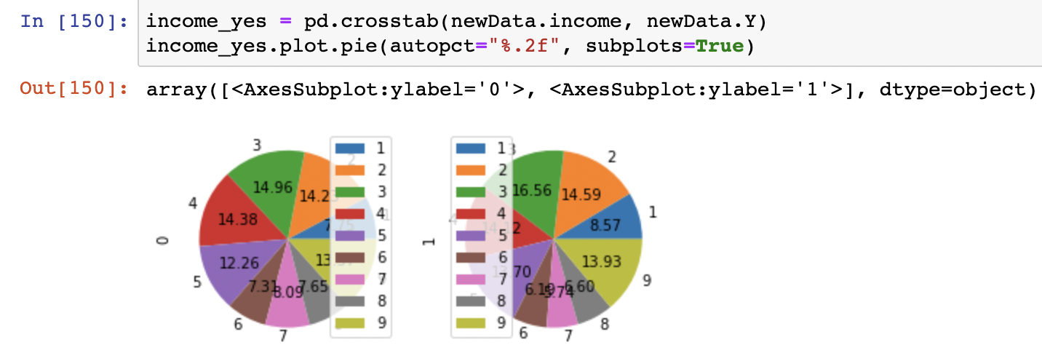
EDA
Represented the distribution of coupons accepted by income. Had each variable be put in numerical values with income going from {1: Less than $12500, 2: $12500 - $24999, 3: $25000 - $37499, 4: $37500 - $49999, 5: $50000 - $62499, 6: $62500 - $74999, 7: $75000 - $87499, 8: $87500 - $99999, 9: $100000 or More}. The two graphs represent coupon accepted (1) and coupon rejected (0), so looking at the second graph, we can see that the largest proportion was group 3 @ 16.56% acceptance.

Slide 7
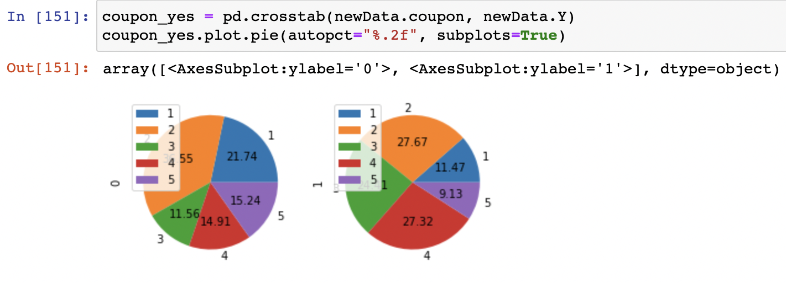
EDA
Following the same procedure as above, this chart illustrates the distribution of coupon acceptance by coupon type. Each integer value represents a type of coupon{1: Bar, 2: Coffee House, 3: Carry out & Take away, 4: Restaurants < $20, 5: Restaurants ($20-$50). The two graphs represent coupon accepted (1) and coupon rejected (0), so looking at the second graph, we can see that the largest proportion was group 2 @ 27.67% acceptance.

Slide 8
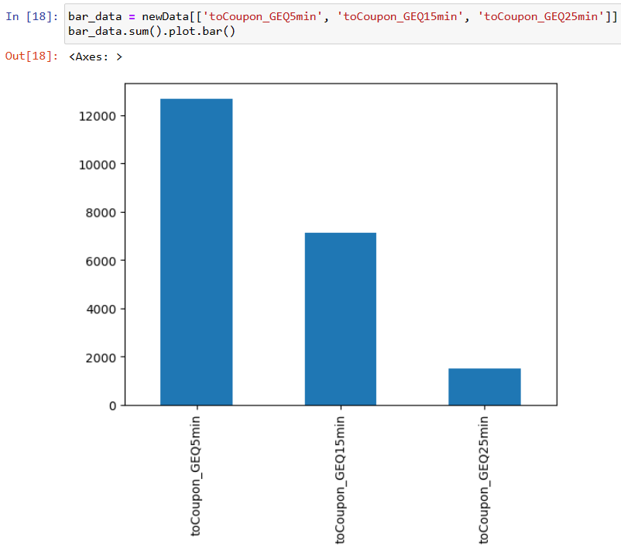
EDA
This bar graph depicts a key variable that could determine whether a person would accept a coupon recommended to them.
Each bar represents the amount of time it takes to get to the destination that the coupon is advertising.
For example, the first bar represents destinations that are greater than or equal to 5 minutes; the second is greater than or equal to 15 minutes; and the third is greater than or equal to 25 minutes.
The coupons whose destination is within 5 to 15 minutes is clearly shown to be the most accepted by people.

Slide 9
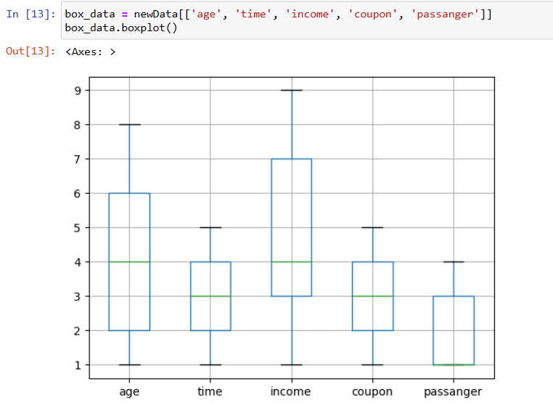
EDA
This boxplot also shows the distribution of some important variables that can influence the person's choice of accepting a coupon.
For age, the range of 1-9 represents an age range of 0 to 50+. ie: 1 = below 21, 2 = 21-26, 3 = 26-31, 4 = 31-36, 5 = 36-41, 6 = 41-46, 7 = 46-50, 8 = 50+.
For the variable time, represents the times where people were surveyed for accepting coupons. the range is from 1-5 where 1 = 7am, 2 = 10am, 3 = 2pm, 4 = 6pm, and 5 = 10pm.
For the variable income, it represents the distribution of income amongst those surveyed. The range is from 1 to 9, where it starts from 0 to $12500 and increments by $12500 each mark.
For the variable coupon, it represents what type of establishment the coupon is for. 1 = Bar, 2 = Coffee House, 3 = Carry out and Take Away, 4 = Restaurant under $20, 5 = Restaurant between $20 to $50. "For the variable passanger, this represents what kind of company the person has with in the car. 1 = Alone, 2 = Kid/Kids, 3 = Friend/Friends, 4 = Partner.
For the variable passanger, this represents what kind of company the person has with in the car. 1 = Alone, 2 = Kid/Kids, 3 = Friend/Friends, 4 = Partner.

Slide 10
K Nearest Neighbors
Main Question: Whether a person will accept the coupon recommended to them in different driving scenarios
OVERVIEW:
Identify independent and dependent variables
Find the best k value
Use model for KNN classification
Evaluated the model’s performance

Slide 11
1. Identify independent and dependent variables
Independent Variables (X):
Destination - No Urgent Place, Home, Work
Passenger - Alone, Friend(s), Kid(s), Partner (who are the passengers in the car)
Weather - Sunny, Rainy, Snowy
Temperature - 55, 80, 30
Time - 2PM, 10AM, 6PM, 7AM, 10PM
Coupon - Restaurant(<$20), Coffee House, Carry out & Take away, Bar, Restaurant($20-$50)
Expiration - 1d, 2h (the coupon expires in 1 day or in 2 hours)
Gender - Female, Male
Age - 21, 46, 26, 31, 41, 50plus, 36, below21
Marital Status - Unmarried partner, Single, Married partner, Divorced, Widowed
has_Children - 1, 0
Income: $37500 - $49999, $62500 - $74999, $12500 - $24999, $75000 - $87499, $50000 - $62499, $25000 - $37499, $100000 or More, $87500 - $99999, Less than $12500
Direction_same - 0, 1 (whether the restaurant/bar is in the same direction as your current destination)
Direction_opp - 1, 0 (whether the restaurant/bar is in the same direction as your current destination)
Bar - never, less1, 1~3, 4~8, gt8 (how many times do you go to a bar every month?)
CoffeeHouse - never, less1, 1~3, 4~8, gt8 (how many times do you go to a coffeehouse every month?)
CarryAway - never, less1, 1~3, 4~8, gt8 (how many times do you get take-away food every month?)
RestaurantLessThan20 - never, less1, 1~3, 4~8, gt8 (how many times do you go to a restaurant with an average expense per person of less than $20 every month?)
Restaurant20To50 - never, less1, 1~3, 4~8, gt8 (how many times do you go to a restaurant with average expense per person of $20 - $50 every month?)
toCoupon_GEQ15min - 0,1 (driving distance to the restaurant/bar for using the coupon is greater than 15 minutes)
toCoupon_GEQ25min - 0, 1 (driving distance to the restaurant/bar for using the coupon is greater than 25 minutes)

Slide 12
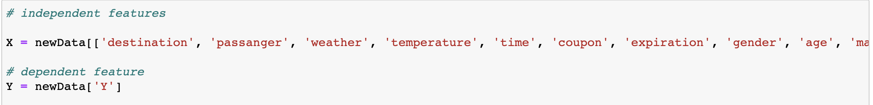
1. Identify independent and dependent variables
Dependent Variable (Y):
Y - 1, 0 (whether the coupon is accepted or not)
Code:

Slide 13
2. Find the best k value
Test a range of k values:
Minimum value = 1
Maximum value = √n (n = number of total observations) = 113
Elbow Method - Plot the accuracies of various potential k values and find the “elbow of the curve.” This is the k value where the accuracy is the highest.

Slide 14
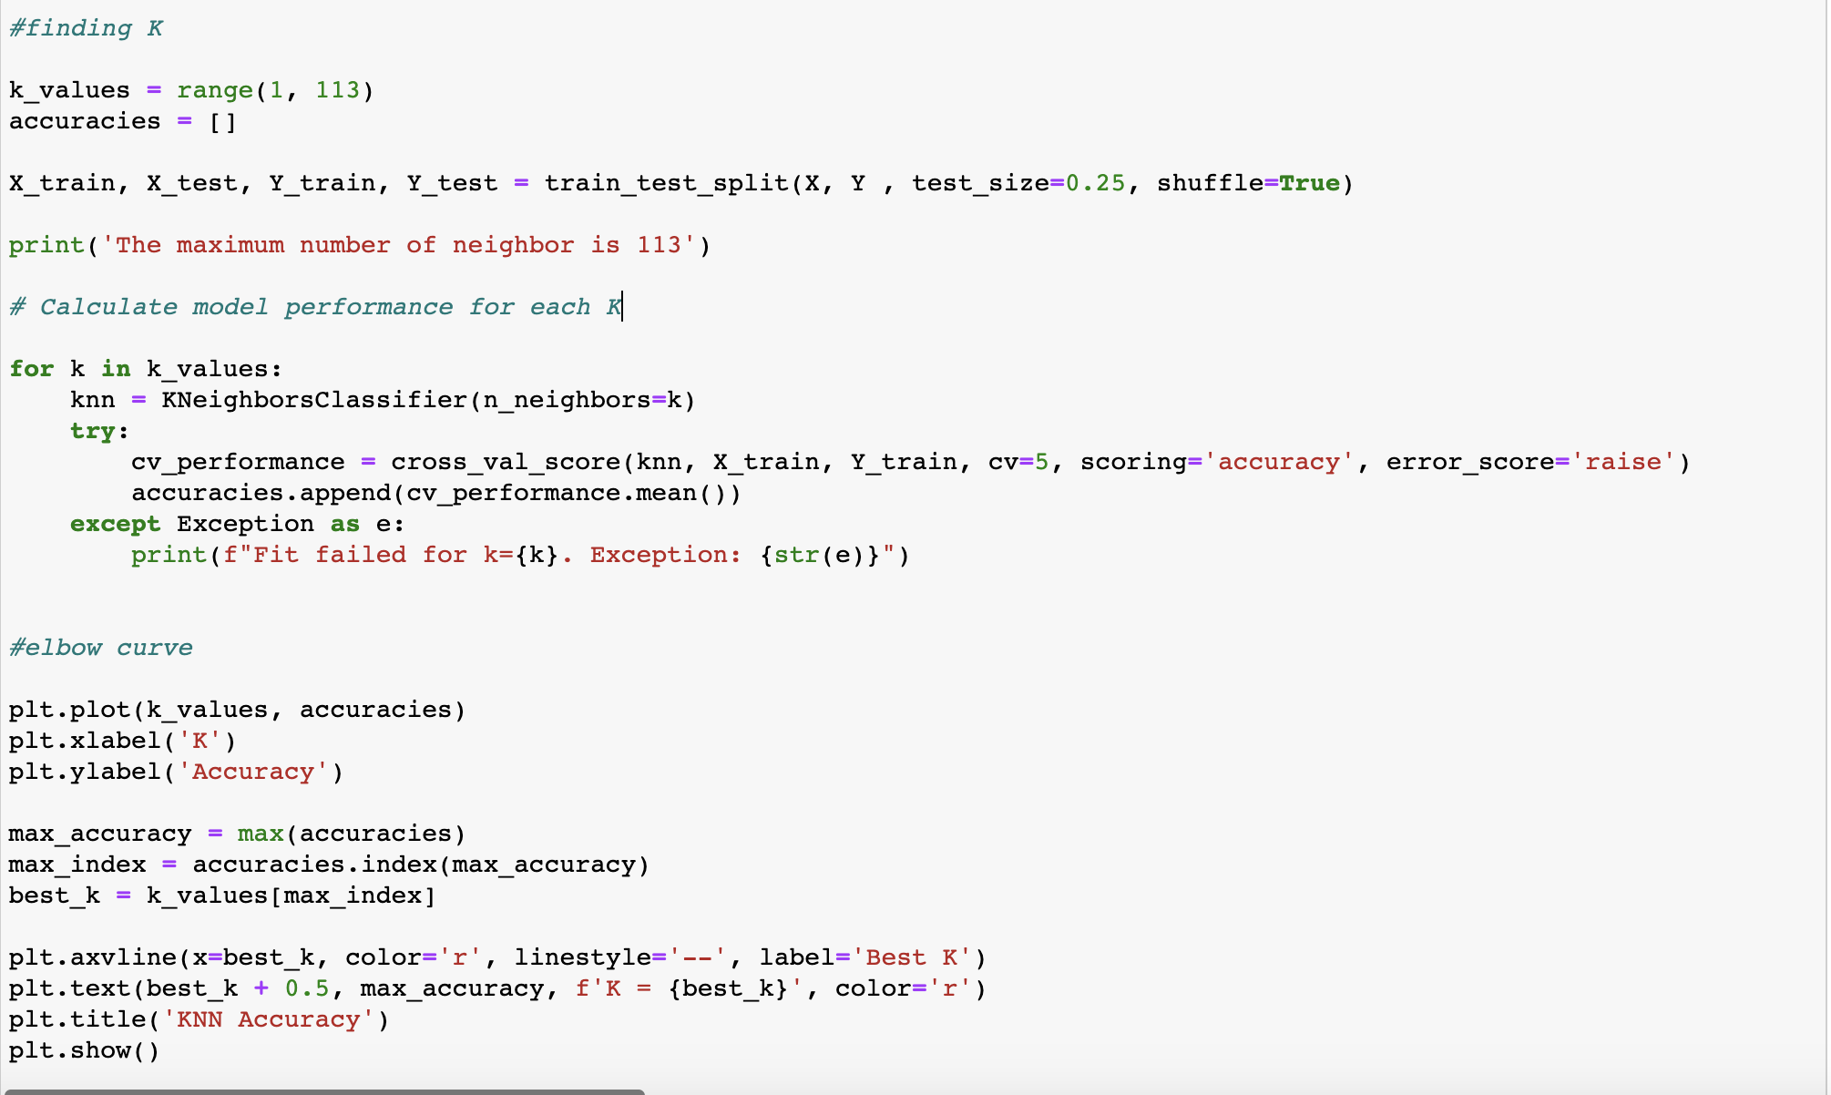
2. Find the best k value
Elbow Method (Code):

Slide 15
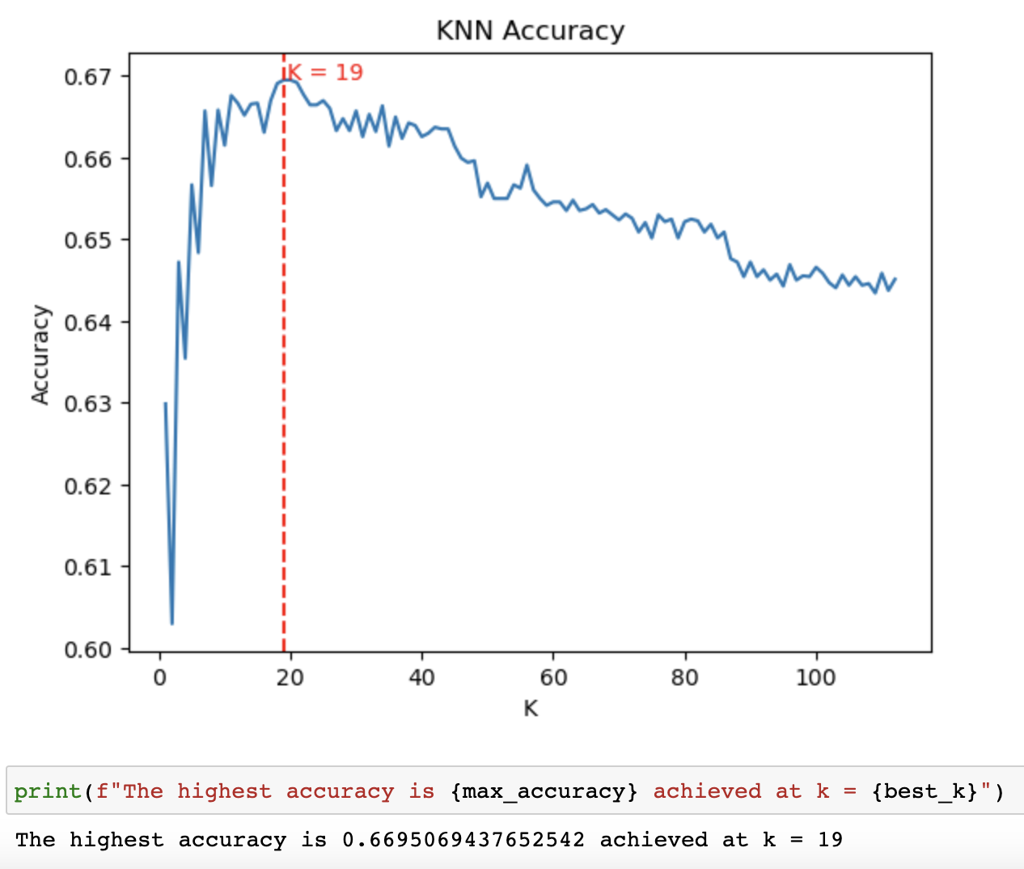
2. Find the best k value
Elbow Method Results:

Slide 16
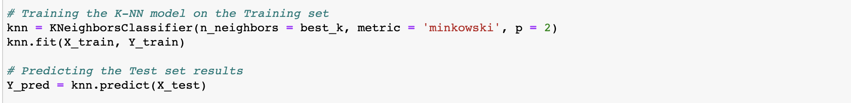
3. Use model for KNN classification
Train the model using the entire dataset:
(Results in a series of 0s and 1s indicating if coupon is accepted or not.)

Slide 17
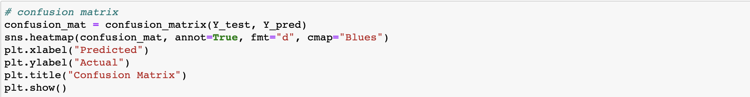
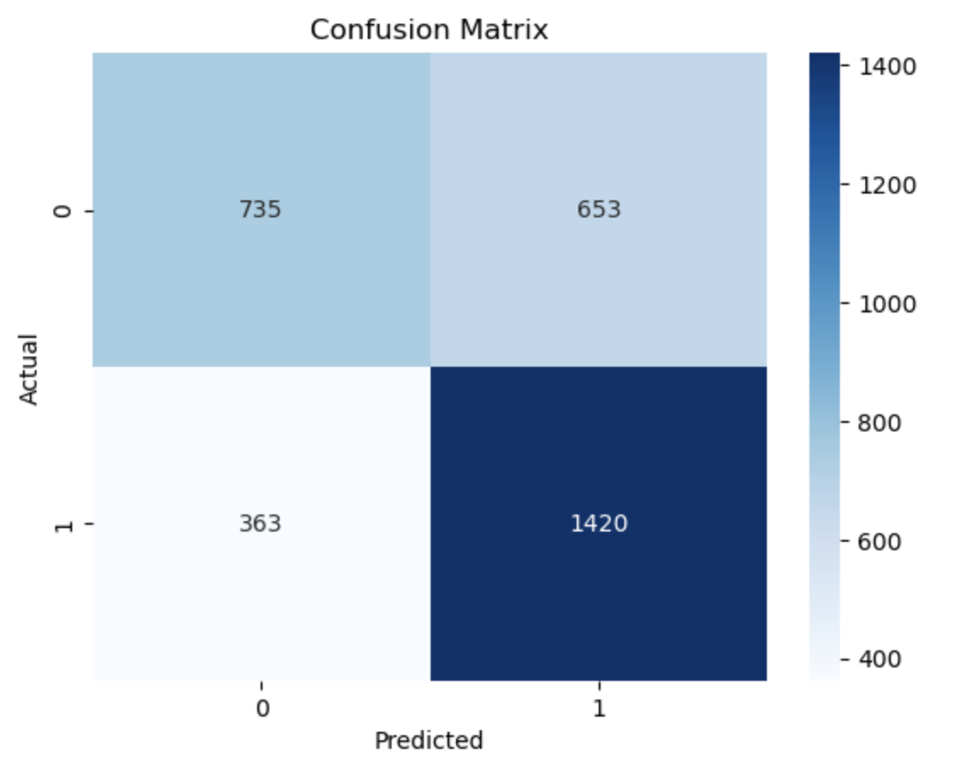
4. Evaluated the model’s performance
Confusion Matrix:

Slide 18
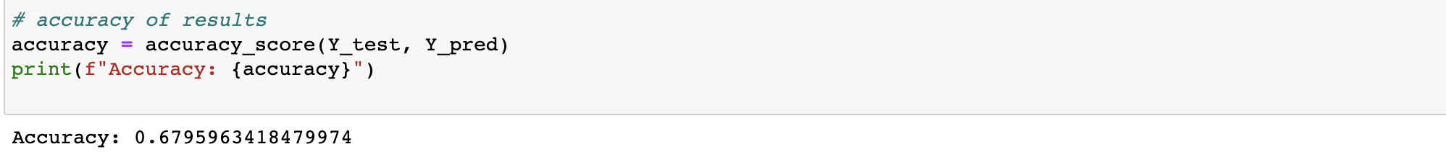
4. Evaluated the model’s performance
Accuracy
Recall
Precision

Slide 19
Questions
Using the confusion matrix, calculate the accuracy (True Positive + True Negative) / Total
What did we use to replace the NaNs when cleaning the data?
What variable do you think would have the greatest impact on if the driver would accept the coupon?

